Slide 1

Department of ECE
GE19612 - Professional Readiness for Innovation, Employability and Entrepreneurship (Mini Project)
2023-24- Even
III Year ECE C section

Slide 2
AI Based Advanced Mobile Seismic Monitoring System Using LSTM Architecture
Batch Members :
Ritvik Prasad M 210801159
Nityasri Kumar P N 210801127
Tharun 210801703
Supervisor:
Dr. M. Sathish, M.E., Ph.D.,
Professor, ECE

Slide 3
Outline
Abstract
Objective
Literature Survey
Summary of Literature
Proposed System & Novelty
Block Diagram
Hardware/Software requirements
References

Slide 4
Abstract
AI based advanced mobile seismic monitoring system using LSTM architecture introduces a paradigm shift in seismic analysis and disaster management by integrating cutting-edge technology with portable sensor solutions. Traditional seismic monitoring methods are often hindered by their stationary nature and high costs, limiting their deployment to well-funded institutions and urban areas. This project leverages the MPU6050 sensor, coupled with LSTM recurrent neural networks, to enable real-time analysis of seismic activity with unparalleled accuracy and efficiency. By predicting Richter scale readings directly from sensor data, this project eliminates the need for costly Richter scales, making seismic monitoring accessible even in resource-constrained rural and remote areas.

Slide 5
Objectives
To develop a portable seismic monitoring system using affordable sensors to enable real-time data collection and analysis in areas lacking established monitoring infrastructure.
To ensure scalability and accessibility by designing the system to be cost- effective, easy to deploy, and user-friendly, thereby democratizing access to seismic monitoring technology and empowering communities to monitor and respond to seismic events effectively.
To implement advanced deep learning techniques, such as LSTM (Long Short Term Memory) neural networks, to analyze seismic data and calculate Richter scale magnitudes, facilitating rapid detection and prediction of seismic events with high accuracy and efficiency.

Slide 6
Literature Survey
TITLE | YEAR | AUTHOR | TECHNIQUE
Implementation of Random Forest Classifier for Real-time Earthquake Detection System | 2023 | Junior R. , A. Murti, D. Rahmawati | The study proposed a solution using a random forest classifier for earthquake detection, demonstrating its effectiveness in discerning between earthquake and non-earthquake vibrations.
Earthquake Prediction Using QSVM | 2024 | Katole A. , V. Batheja, A. Deshmukh, F. Dekate, A. Soni | The study proposed the used of quantum support vector machines to predict the timing of laboratory earthquakes.
Classification of Earthquake Vibrations Using the ANN (Artificial Neural Network) Algorithm | 2023 | Tasa F. A. , Istiqomah, M. A. Murti and I. Alinursafa | The study employed artificial neural network (ANN) algorithm to classify earthquake vibrations after extracting various features from the data.
Rapid Earthquake Magnitude Classification Using Single Station Data Based on Machine Learning | 2023 | Zhu J. et al | The study introduced a machine learning magnitude classification framework (MCFrame) designed to rapidly and accurately classify earthquake events into high magnitude (M≥5.5) or low magnitude (M<5.5) categories using single station data.

Slide 7
Proposed System
Integrates hardware components, including the Raspberry Pi 5, MPU-6050 accelerometer module, and 2.4GHz (ISM band) antenna to create a seismic monitoring solution.
Raspberry Pi 5 serves as the computation unit, providing computational power and connectivity for data analysis and transmission. Its compact size and low power consumption make it ideal for deployment in portable monitoring systems.
MPU-6050 accelerometer module, the system can accurately detect and measure seismic vibrations in multiple axes.
2.4GHz antenna facilitates wireless communication between monitoring nodes, enabling real-time data transmission and remote monitoring capabilities upto an optimum range of approximately 200 acres.

Slide 8
Novelty in Proposed System
Richter Scale Prediction: A groundbreaking feature of the Advanced Seismic Monitoring System is its capability to predict Richter scale readings directly from the sensor data, eliminating the need for traditional Richter scales. By training an LSTM neural network on accelerometer and gyroscope readings from the calibrated MPU6050 sensor, the system can accurately estimate Richter scale magnitudes in real-time.
Cost-effective Deployment: The AI based advanced mobile seismic monitoring system using LSTM architecture offers a cost-effective solution for seismic monitoring in resource-constrained environments. By utilizing affordable components and open-source software, the system democratizes access to seismic monitoring technology, empowering communities and researchers to address seismic hazards effectively.

Slide 9
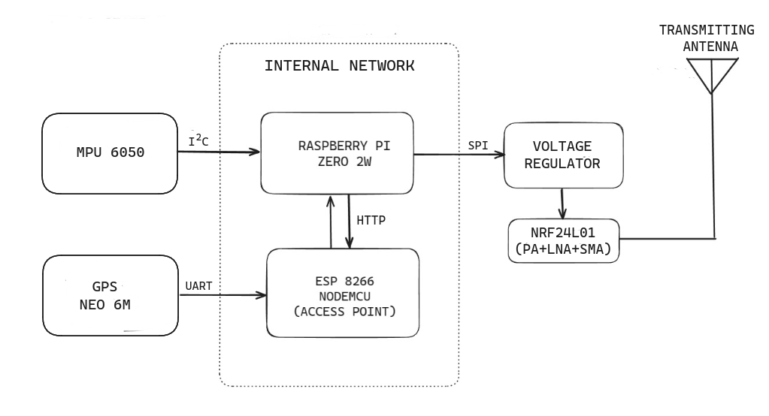
Block Diagram
The following block diagram shows the working of mobile station of the project.

Slide 10
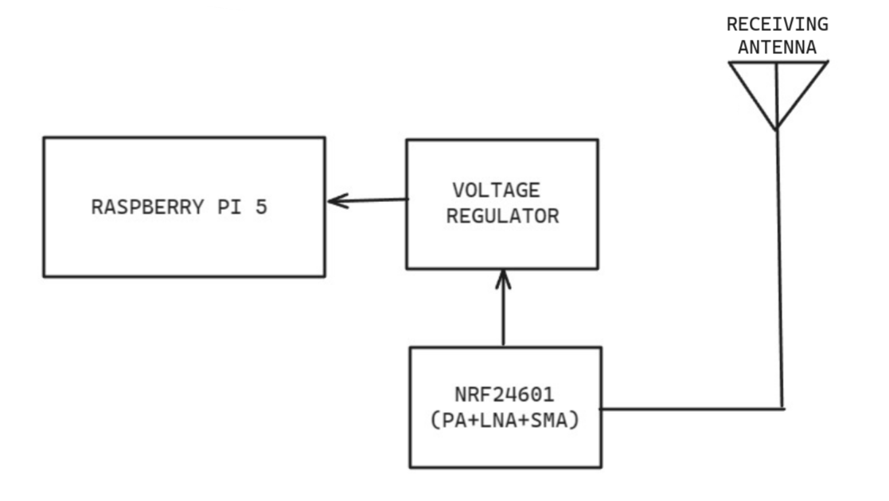
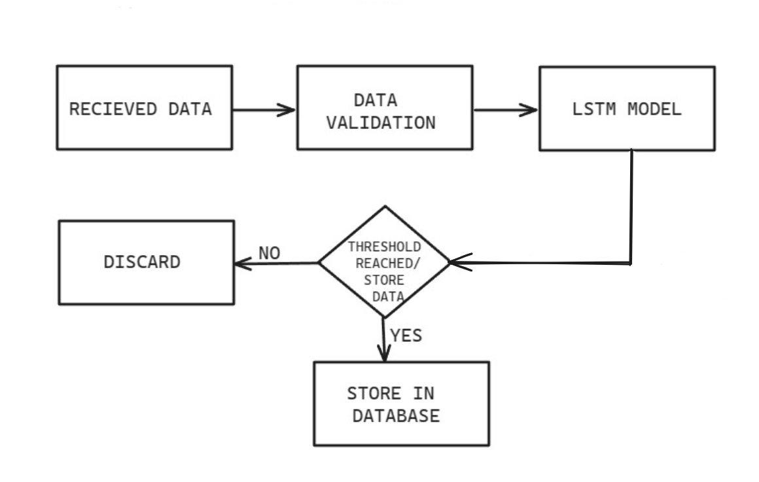
The following diagrams shows the block diagram of the mobile station and the sofware flow diagram at the base station.

Slide 11
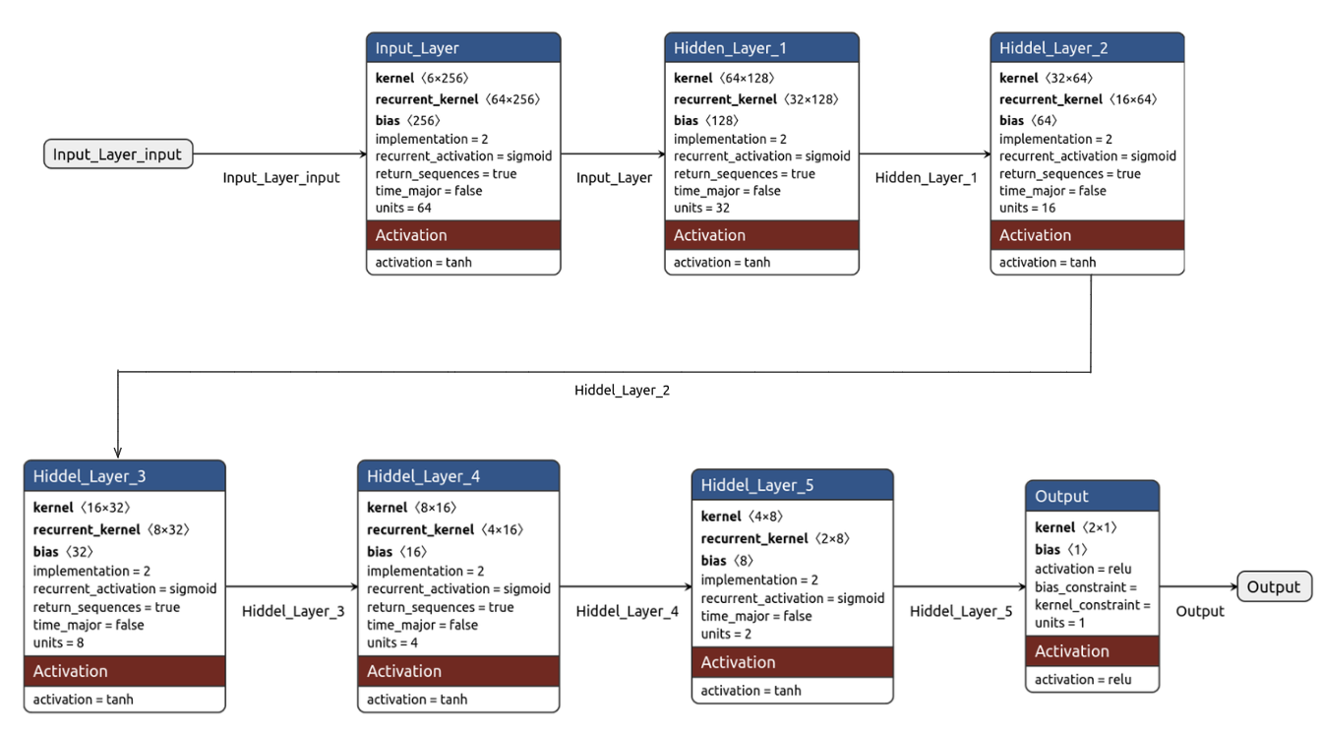
Software Architecture
The following diagram shows the architecture of the LSTM model used at the computational unit.

Slide 12
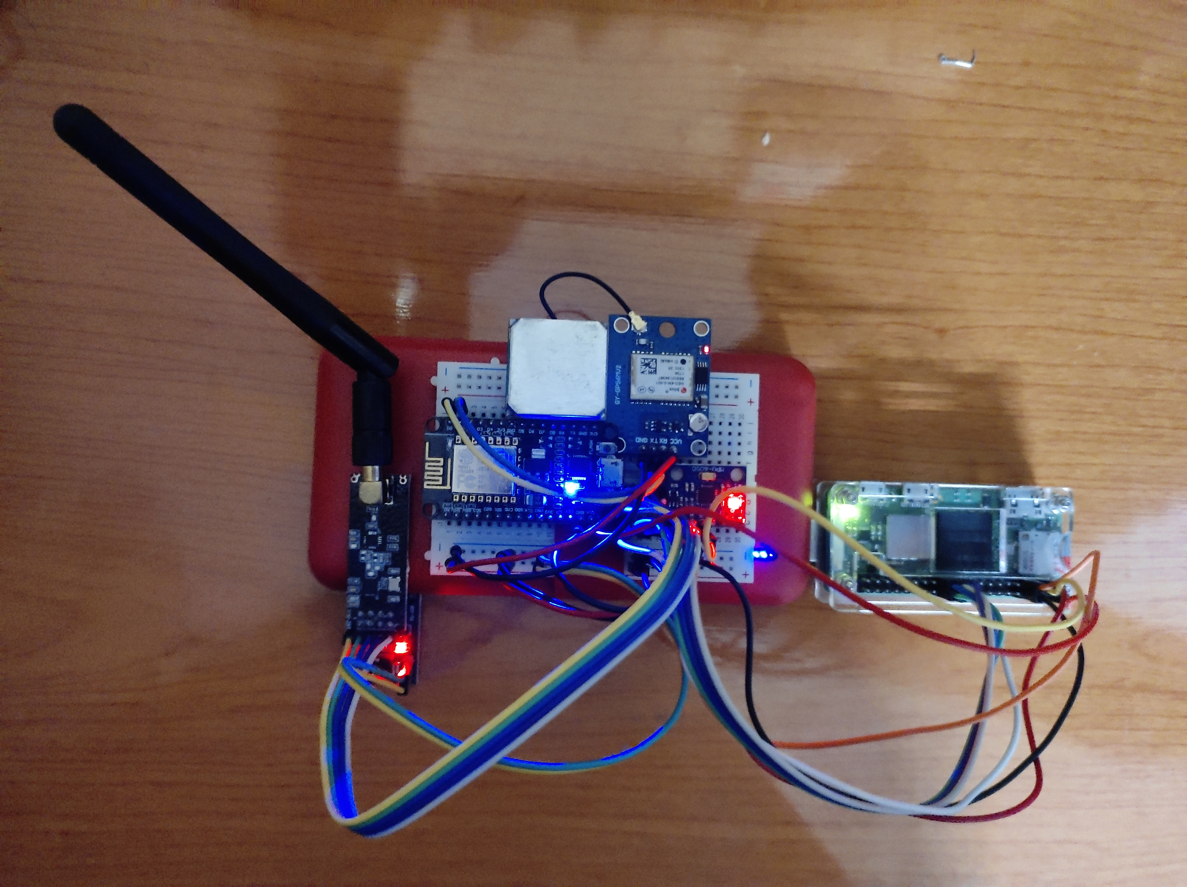
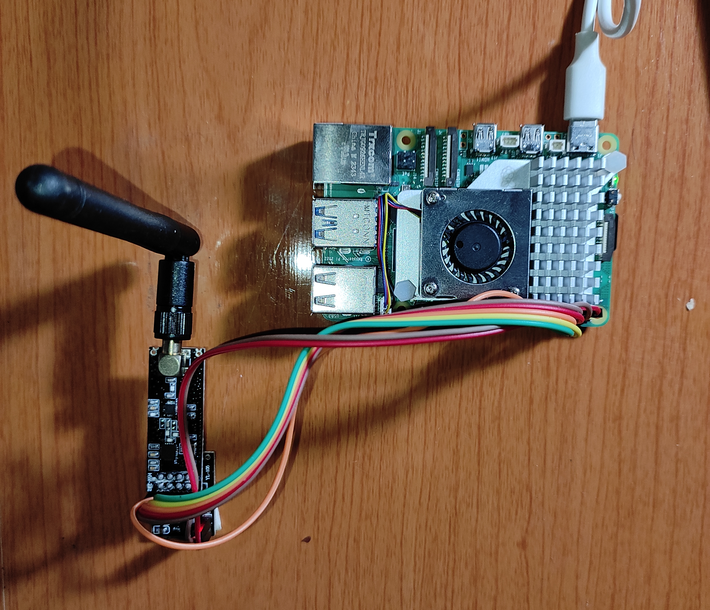
Prototype

Slide 13
Hardware/Software Requirements
Hardware Requirement
Raspberry pi 5 / Computational Unit
Raspberry pi zero (mobile unit)
2.4GHz Half Duplex Transreciever
3-axis Accelerometer
Software Requirement
Linux Environment (server)
Pytorch
Micropython

Slide 14
References
Junior R. , A. Murti and D. Rahmawati, (2023) "Implementation of Random Forest Classifier for Real-time Earthquake Detection System," 2023 IEEE International Conference on Industry 4.0, Artificial Intelligence, and Communications Technology (IAICT), BALI, Indonesia, 2023, pp. 227-23
Katole A. , V. Batheja, A. Deshmukh, F. Dekate and A. Soni, (2024) "Earthquake Prediction Using QSVM," 2024 IEEE International Students' Conference on Electrical, Electronics and Computer Science (SCEECS), Bhopal, India, 2024, pp. 1-7
Tasa F. A. , Istiqomah, M. A. Murti and I. Alinursafa, (2022) "Classification of Earthquake Vibrations Using the ANN (Artificial Neural Network) Algorithm," 2022 IEEE International Conference on Industry 4.0, Artificial Intelligence, and Communications Technology (IAICT), BALI, Indonesia, 2022, pp. 102-107
Zhu J. et al., (2024) "Rapid Earthquake Magnitude Classification Using Single Station Data Based on the Machine Learning," in IEEE Geoscience and Remote Sensing Letters, vol. 21, pp. 1-5

